Slide 1
A Shared Developmental Approach: Meeting Well-being Needs and Addressing Trauma
CLARE ANDERSON, DEPUTY COMMISSIONER ADMINISTRATION ON CHILDREN, YOUTH AND FAMILIES

Slide 2
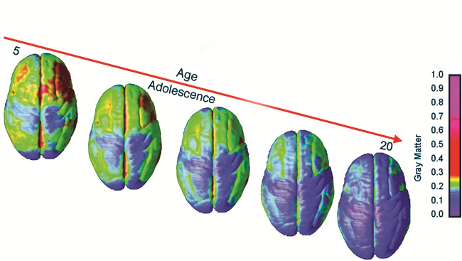
USING THE NEUROSCIENCE TO INFORM A DEVELOPMENTAL APPROACH

Slide 3
A HISTORY OF MALTREATMENT IS THE NORM AMONG CHILDREN AND YOUTH IN MANY SYSTEMS
Miller, EA; Green, AE; Fettes, DL; & Aarons, GA., 2011. Data come from a representative sample of 1,715 youths aged 6–18 who received services from one or more of five San Diego County public sectors of care.

Slide 4
BRAIN DEVELOPMENT PATTERNS
Traumatic Stress
BRAIN
Hormones, chemicals, and cellular systems prepare for a tough life in an evil world
INDIVIDUAL
> Edgy
> Hot temper
> Hyper vigilant
> “Brawn over brains”
OUTCOME
Individual and species survive the worst conditions
NEUTRAL START
BRAIN
Hormones, chemicals, and cellular systems prepare for life in a benevolent world
INDIVIDUAL
> Laid back
> Relationship-oriented
> Think things through
> “Process over power”
OUTCOME
Individual and species live peacefully in good times; vulnerable in poor conditions
Adapted from: Family Policy Council. (2007). The High Cost of Adverse Childhood Experiences (PPT). Olympia, WA: Author.
Effective screening and assessment help identify children who have trauma symptoms; evidence-based interventions and strategies help restore developmentally appropriate functioning.

Slide 5
The Causal Impact of Childhood-Limited Maltreatment and Adolescent
Maltreatment on Early Adult Adjustment
Maltreatment during adolescence has a significant effect on a broader range of outcomes [than childhood limited maltreatment]:
official arrest or incarceration,
self-reported criminal offending,
violent crime,
alcohol use,
problem alcohol use, drug use, problem drug use,
risky sex behaviors,
self-reported sexually transmitted disease diagnosis, and
suicidal thoughts.
Preventing maltreatment and providing services to reduce its negative sequelae are likely to have major benefits for society given the extensive damage
to later functioning that maltreatment seems to cause.
T.P. Thornberry et al. / Journal of Adolescent Health 46 (2010) 359–365

Slide 6
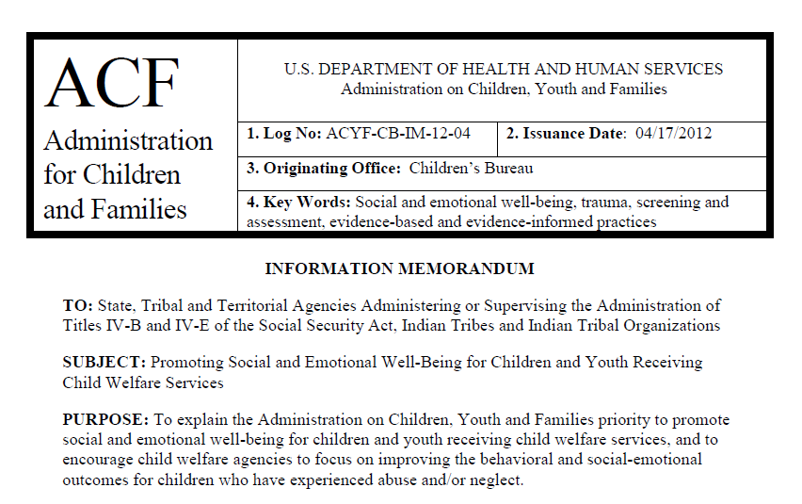
Policy: Social and Emotional Well-Being
http://www.acf.hhs.gov/programs/cb/laws_policies/policy/im/2012/im1204.pdf

Slide 7
A DEVELOPMENTAL FRAMEWORK FOR WELL-BEING
The framework identifies four basic domains of well being: (a) cognitive functioning, (b) physical health and development, (c) behavioral/emotional functioning, and (d) social functioning. Within each domain, the characteristics of healthy functioning related directly to how children and youth navigate their daily lives: how they engage in relationships, cope with challenges, and handle responsibilities.
Cognitive Functioning
Physical Health and Development
Environmental Supports
Personal Characteristics
Emotional/ Behavioral Functioning
Social Functioning
Developmental Stage (e.g., early childhood, latency)

Slide 8
A DEVELOPMENTAL FRAMEWORK FOR WELL-BEING
 | Intermediate Outcome Domains |  | Well-Being Outcome Domains
 | Environmental Supports | Personal Characteristics | Cognitive Functioning | Physical Health and Development | Emotional/Behavioral Functioning | Social Functioning
Infancy (0-2) | Family income, family social capital, community factors (e.g., institutional resources, collective socialization, community organization, neighborhood SES) | Temperament, cognitive ability | Language development | Normative standards for growth and development, gross motor and fine motor skills, overall health, BMI | Self-control, emotional management and expression, internalizing and externalizing behaviors, trauma symptoms | Social competencies, attachment and caregiver relationships, adaptive behavior
Early Childhood (3-5) | Family income, family social capital, community factors (e.g., institutional resources, collective socialization, community organization, neighborhood SES) | Temperament, cognitive ability | Language development, pre-academic skills (e.g., numeracy), approaches to learning, problem-solving skills | Normative standards for growth and development, gross motor and fine motor skills, overall health, BMI | Self-control, self-esteem, emotional management and expression, internalizing and externalizing behaviors, trauma symptoms | Social competencies, attachment and caregiver relationships, adaptive behavior
Middle Childhood (6-12) | Family income, family social capital, social support, community factors (e.g., institutional resources, collective socialization, community organization, neighborhood SES) | Identity development, self-concept, self-esteem, self-efficacy, cognitive ability | Academic achievement, school engagement, school attachment, problem-solving skills, decision-making | Normative standards for growth and development, overall health, BMI, risk-avoidance behavior related to health | Emotional intelligence, self-efficacy, motivation, self-control, prosocial behavior, positive outlook, coping, internalizing and externalizing behaviors, trauma symptoms | Social competencies, social connections and relationships, social skills, adaptive behavior
Adolescence (13-18) | Family income, family social capital, social support, community factors (e.g., institutional resources, collective socialization, community organization, neighborhood SES) | Identity development, self-concept, self-esteem, self-efficacy, cognitive ability | Academic achievement, school engagement, school attachment, problem solving skills, decision-making | Overall health, BMI, risk-avoidance behavior related to health | Emotional intelligence, self-efficacy, motivation, self-control, prosocial behavior, positive outlook, coping, internalizing and externalizing behaviors, trauma symptoms | Social competence, social connections and relationships, social skills, adaptive behavior
 |  |  |  |  | Social and Emotional Well-Being Domains

Slide 9
ACHIEVING BETTER OUTCOMES
context: therapeutic, responsive & supportive settings & relationships
Validated Screening
Case Planning for Safety, Permanency, and Well-being
Outcomes: Safety, Permanency, Well-Being
Evidence-based Intervention(s)
Clinical Assessment
Functional Assessment
Progress Monitoring
social-emotional functioning

Slide 10
BLOG: Helping victims of childhood trauma heal and recover – July 11, 2013
http://www.hhs.gov/secretary/about/opeds/childhood-trauma-recover.html
Dear State Director Letter – HHS: CMS, SAMHSA and ACF
The impact of complex trauma for children who have experienced maltreatment can be profound, derailing them from healthy development, impairing social and emotional functioning, and compromising health. These effects can be addressed, however, and children can heal and recover. CMS, SAMHSA, and ACF are committed to improving the life outcomes for children who have experienced the complex trauma associated with child abuse and neglect and exposure to violence and are prepared to offer technical assistance as needed.
This guidance letter is intended to encourage the integrated use of trauma-focused screening, functional assessments and evidence-based practices (EBPs) in child-serving settings for the purpose of improving child well-being.
http://www.medicaid.gov/Federal-Policy-Guidance/Downloads/SMD-13-004.pdf

Slide 11
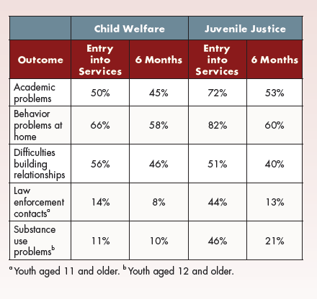
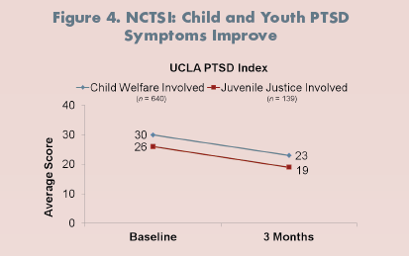
ADDRESSING TRAUMA IMPROVES OUTCOMES ACROSS SYSTEMS
NCTSI centers train professionals from juvenile justice and child welfare agencies on how to adopt trauma-informed perspectives and deliver trauma-focused evidence-based practices, including Trauma-Focused Cognitive Behavioral Therapy (TF-CBT); Attachment, Self-Regulation, and Competency (ARC); Child-Parent Psychotherapy (CPP); and Structured Psychotherapy for Adolescents Responding to Chronic Stress (SPARCS).
http://www.samhsa.gov/children/SAMHSA_ShortReport_2012.pdf

Slide 12
SHARED DEVELOPMENTAL APPROACH: CHILD WELFARE AND JUVENILE JUSTICE
Cognitive Functioning
Physical Health and Development
Emotional/
Behavioral Functioning
Social Functioning

